Slide 1


Elliptic Curve Cryptography
Ms. Swati Mali
swatimali@somaiya.edu
Assistant Professor, Department of Computer Engineering
K. J. Somaiya College of Engineering
Somaiya Vidyavihar University

Slide 2
Why ECC?
Better security even with shorter key length than RSA
less processing overhead
stronger than RSA for the key size in use today
typical ECC key size of 256 bits is equivalent to a 3072-bit RSA key and
10,000 times stronger than a 2048-bit RSA key!

Slide 3
Advantages of ECC
Very fast key generation.
Smaller keys, cipher-texts, and signatures.
Fast signatures.
Signatures can be computed in two stages, allowing latency much lower.
Moderately fast encryption and decryption.
Than inverse throughput.
Right protocols for authenticated key exchange (FH-ECMQV et al.).
Better US government support.
Binary curves are fast in hardware.
Unique curves with bilinear pairings allow new-fangled crypto
Signature generation is faster with RSA.

Slide 4
Elliptic Curve Digital Signature Algorithm or ECDSA is a cryptographic algorithm used by Bitcoin
one-way encryption of emails, data and software.
a standard for encryption that will be used by most web applications going forward due to its shorter key length and efficiency.
Websites make extensive use of ECC to secure customers’ hypertext transfer protocol connections.
It is used for encryption by combining the key agreement with a symmetric encryption scheme.

Slide 5
U.S. government uses it to protect internal communications,
the Tor project uses it to help assure anonymity,
it provides signatures in Apple's iMessage service,
it is used to encrypt DNS information with DNSCurve,
preferred method for authentication for secure web browsing over SSL/TLS.

Slide 6
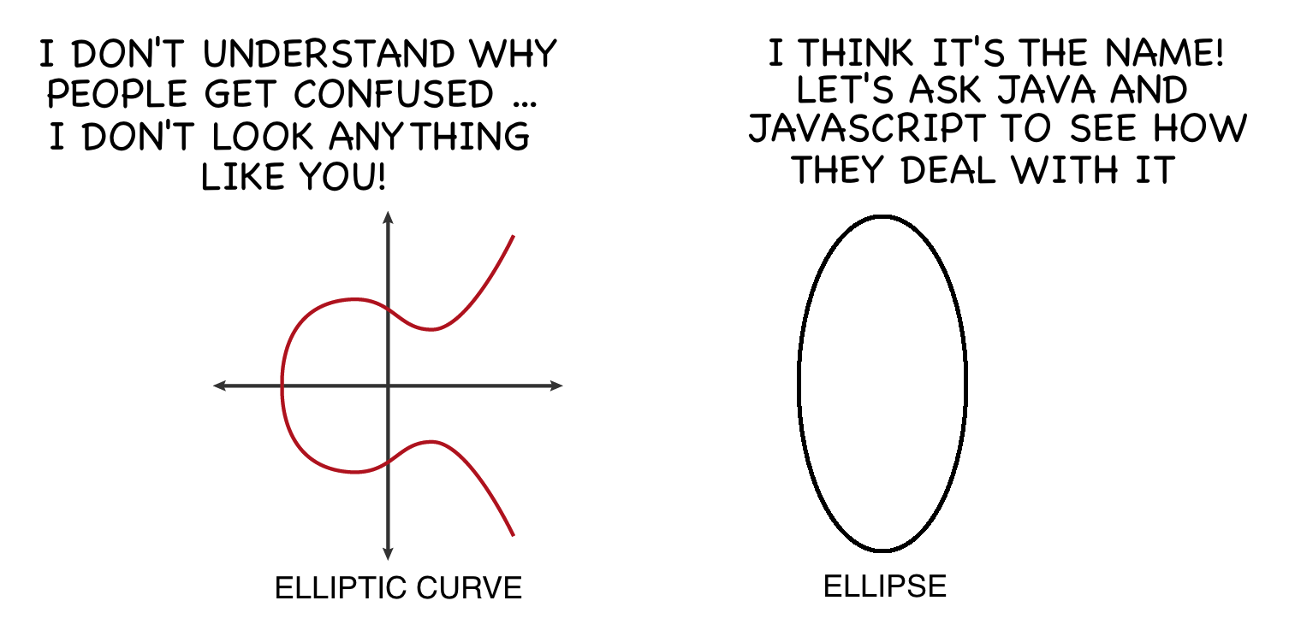

Slide 7
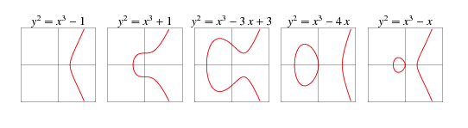
Elliptic curves are geometric objects
They don’t resemble ellipses in any way,
and they are not defined by ellipses either.
Yet, the word “elliptic” is really close to the word “ellipse”.
In an ellipse, two lines starting from the center of the ellipse to two different points on the circumference form an arc

Slide 8
Elliptic functions and Elliptic Curve
the functions those compute length of the are defined over a particular space,
these functions have a limited set of possible solutions in that space.
these solutions (or points) when plotted, forms a curve and it looks like the curves
These curves are called elliptic curves.
Definition: elliptic curves are the set of points that are obtained as a result of solving elliptic functions over a predefined space.

Slide 9
Elliptic curves are represented with cubic equations similar to ellipse circumference equations
ellipse has cubic equations
ellipse circumference can also be represented with cubic equations
Hence the name elliptical curve cryptography
Elliptic curve equation: Y2 = x3+ax+b
the max number of points on curve are bounded by:
p+1-2 sqrt(p)<=N<=p+1+2 sqrt(p)

Slide 10
technically an elliptic curve is the set points satisfying an equation in two variables with degree two in one of the variables and three in the other.
An elliptic curve is not just a pretty picture, it also has some properties that make it a good setting for cryptography.
Horizontal symmetry: Any point on the curve can be reflected over the x axis and remain the same curve.
A more interesting property is that any non-vertical line will intersect the curve in at most three places.

Slide 11
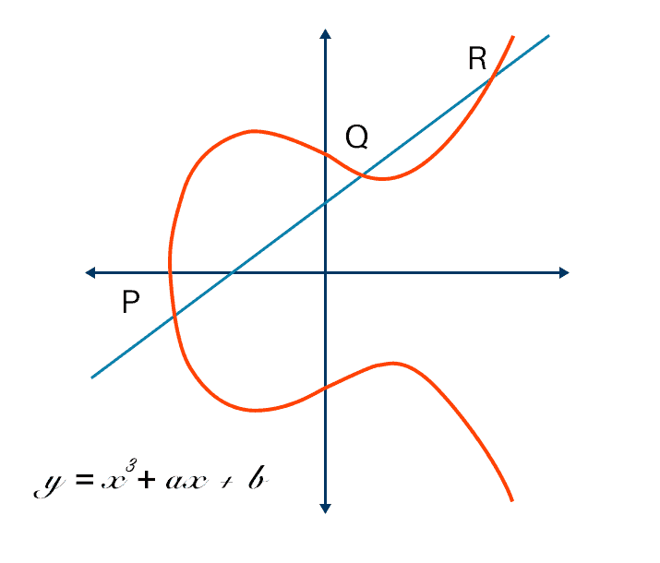
Why Elliptic curves are symmetric?
Y2 = x3+ax+b
⇒ y = sqrt(x3+ax+b)
y has +ve and -ve roots/values on graph (+-x)
when plotted, gives a symmetric curve along y=0

Slide 12
Types of Elliptic Curves
Singular Elliptic Curve
4a³+27b²=0
Y²= x³+ax+b 🡺 LHS has degree 2 while RHS has degree 3
i.e. horizontal line would intersect curve at three points if roots are real
But the vertical line can intersect curve at most in 2 points
Hence, equation does not have 3 distinct roots
Non-Singular Elliptic curve
4a³+27b²!=0
does have 3 distinct roots of the ECC equation
only non-singuler EC are used in cryptography

Slide 13
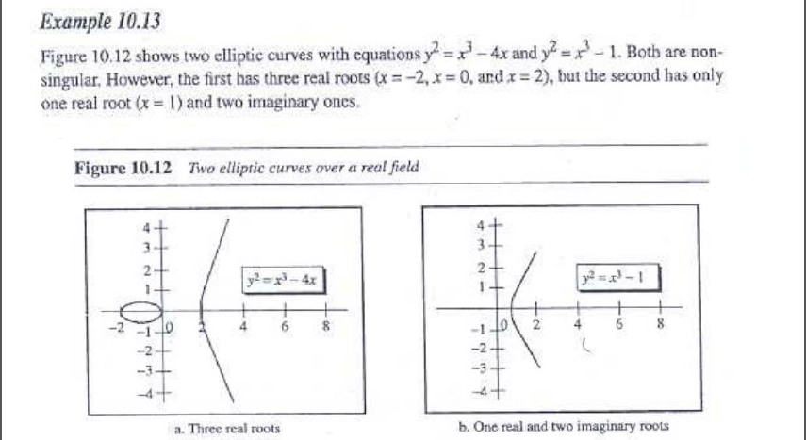

Slide 14
ECC solution and Abelian Group
Closure
For a and b in A, result of a * b is also A
Associativity
a*(b*c) = (a*b)*c
Identity Element
∃ e in A, such that ∀ a in A, e*a=a*e=a holds
Inverse Element
for each a in A, ∃ an element b in A, such that a*b=b*a=e, where e is an identity element
Commutativity
∀ a,b in A, a*b=b*a
A group without a commutative property is a non-Abelian group

Slide 15
Affine points
points on the EC
O points
a point p such that p+(-p) forms an infinity
ECC is defined as
EC over Zp, prime curve
EC over GF(2^m)

Slide 16
EC over Zp
prime curve
equation: y2 mod p = (x^3+ax+b) mod p
variables and coefficients are restricted to finite field
values range from 0 to p-1, values beyond p are taken as value mod p
curve is focusedin only one quadrant from (0,0) through(p-1,p-1) with positive integers

Slide 17
EC over Zp addition
add two points p and q to give r
p: p(xp,yp)
q:q(xq,yq)
r: r(xr,yr)
the point r lies on the line connecting p & q and extending till r
if (p==q)
slope of line λ= (3xp^2+a)/2yp where a comes from Ep equation:Y2 = x3+ax+b
if (p!=q)
slope of line λ= (yq-yp)/(xq-xp)

Slide 18
r(xr,yr)=p(xp,yp)+q(xq,yq) is computed as:
xr= λ^2-xp-xq
yr=λ(xp-xr)-yp

Slide 19
Find a point in Elliptic curve E11(1,1)
Solution: Ep is prime curve, so all points must be limited to p
Ep is represented as Ep(a,b)
so, p=11, a=1, b=1
EC is given by the equation: Y2= X3+x+1
if x=0, y=1 & -1
so, points : (x,y) are (0,1) and (0,-1)
so, for -1 is negative, hence take mod p.
⇒ solution(0,1) (0,10)
Generate more points in range :
p+1-2 sqrt(p)<=N<=p+1+2 sqrt(p)
Use diff values of x & y and generate more points

Slide 20
Given P(3,10) and Q(9,7),
Find P+Q Assume E23(1,1)
Solution: Let P(xp,yp)+Q(xq,yq)=R(xr,yr)
Computing slope of line connecting P & Q
As, P!=Q
λ= (yq-yp)/(xq-xp) =-3/6 =-½ mod 23 = - 2^-1 mod 23
= (-1*-11) mod 23 = 11
xr=11^2-3-9= 109 mod 23 = 17
yr=11(3-17)-10=-164 mod 23 = 20
P+Q = (17,20)

Slide 21
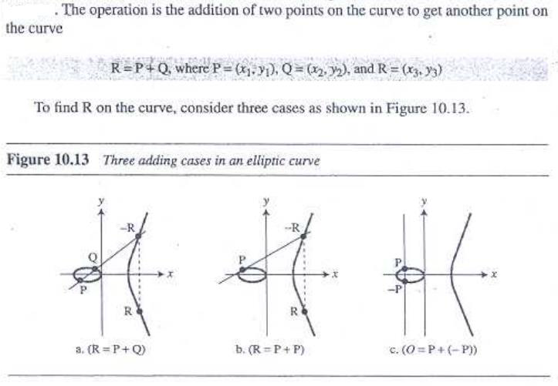
Addition operation on the points of curve

Slide 22
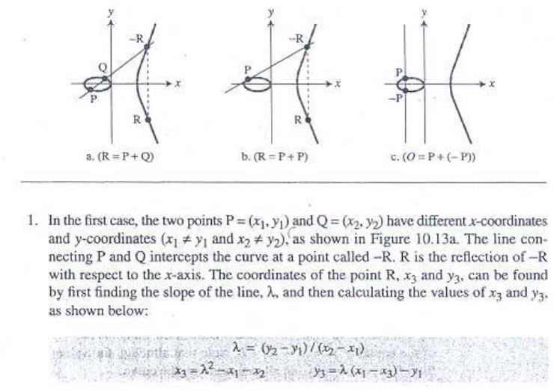

Slide 23
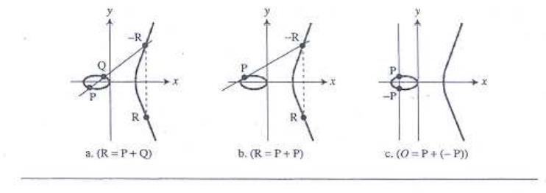
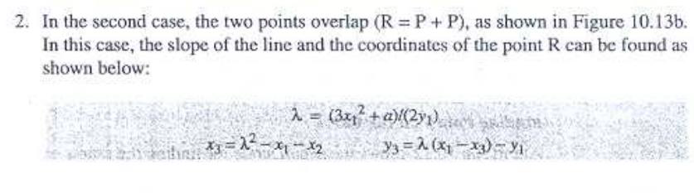

Slide 24
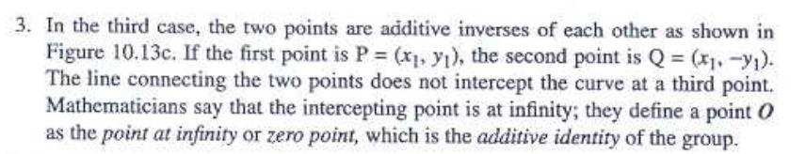

Slide 25
Abelian Group properties revisited
Closure: addition of t
For a and b in A, result of a * b is also A
addition of two points on curve creates another point on curve
Associativity
a*(b*c) = (a*b)*c or a+(b+c) = (a+b)+c
(P+Q)+R = P+(Q+R)
Identity Element
∃ e in A, such that ∀ a in A, e*a=a*e=a or e+0 =0+e=e holds
P+0 = 0+P = P

Slide 26
Inverse Element
for each a in A, ∃ an element b in A, such that a*b=b*a=e or a+b=b+a=e, where e is an identity element
Each point on curve has an inverse
Inverse of a point is its reflection w.r.t the x-axis
i.e. P=(x1,y1) and Q=(x1,-y1) are inverses of each other
Note: identity element is inverse of itself
Commutativity
∀ a,b in A, a*b=b*a or a+b=b+a
A group without a commutative property is a non-Abelian group

Slide 27
A Group and a Field
The group defines the set of points on elliptic curve and the addition operation on points
The field defines addition, subtraction, multiplication and division using operations on real numbers that are needed to find the addition of points in the group

Slide 28
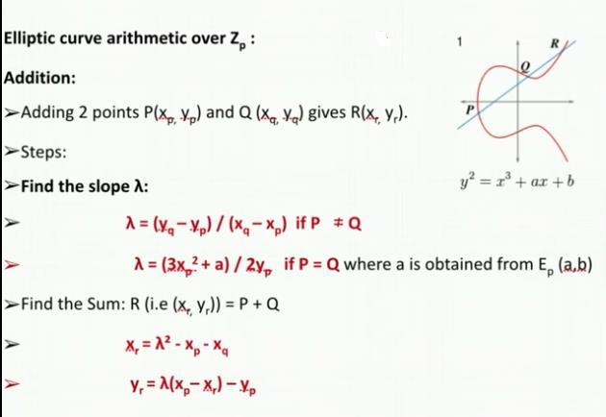
ECC over Zp arithmetic

Slide 29
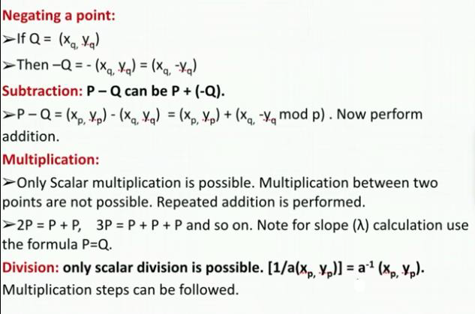
ECC over Zp arithmetic

Slide 30
Example : find matching points on curve in ECC over Zp
Given Elliptic curve : E₁₁(1,6)
p=11, a=1, b=6
Zp ECC is given by y² mod p = x³+ax+b mod p
🡺 y² mod 11 = x³+ax+b mod 11
y2 mod 11 = x³+x+6 mod 11
Range= (0,p-1) 🡺 (0,10)
Values of x & y can be from 0 to 10
Problem: find values of x’,y’ such that
LHS=RHS
Computed point also lies on the elliptic curve

Slide 31
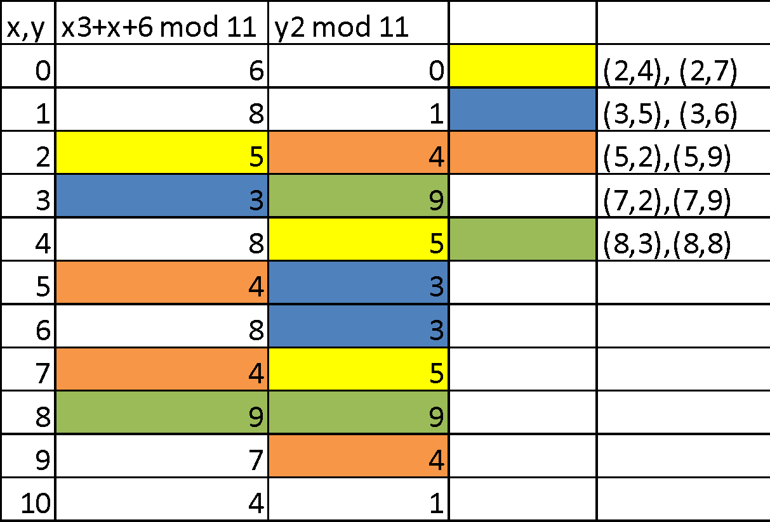
Matching points

Slide 32
Negative number and mod operation
Method 1: Formula : -a mod b = b-(a mod b)
E.g. -3 mod 11 🡺 a=3, b=11
🡺 11-(3 mod 11) 🡺 11-3=8
E.G -34 mod 23 🡺 a=34, b=23
23 –(34 mod 23) = 23 – 11 = 12
Method 2 : if a<b, subtract a from b
Else
Take multiple of b such that it is greater than a
Subtract a from the multiple
Method 3: (-a mod b) + b
Example -157 mod 23 ??

Slide 33
Compute modulo inverse

Slide 34
Elliptic Curve Cryptography
The private keys in the ECC are integers (in the range of the curve's field size, typically 256-bit integers).
Example of 256-bit ECC private key (hex encoded, 32 bytes, 64 hex digits) is: 0x51897b64e85c3f714bba707e867914295a1377a7463a9dae8ea6a8b914246319.
The public keys are points on elliptic curve {x, y}
Example of ECC public key 0x02f54ba86dc1ccb5bed0224d23f01ed87e4a443c47fc690d7797a13d41d2340e1a.

Slide 35
Consequently, in ECC we have:
Еlliptic curve (EC) over finite field 𝔽p
G = generator point (fixed constant, a base point on the EC)
private key =integer
public key =point

Slide 36
Deffie-Hellman Key exchange using ECC- ECDH
ECC key exchange – similar to DH Key exchange
Global public elements
• Eq(a,b) - Elliptic curve parameters – a,b and q – prime no. or integer of the form 2m.
• G – point on the elliptic curve

Slide 37
User A key generation
• Select private key nA, such that nA < n
• Calculate public key PA, PA = nA * G
• User B key generation
• Select private key nB, nB < n
• Calculate public key PB, PB = nB * G
Calculation of secret key by User A, K = nA * PB
• Calculation of secret key by User B, K = nB * PA

Slide 38
we compute some q= k*p where q,p ∈ Ep(a,b)
Given k & p its easy to compute q
but, knowing p & q, it's difficult to compute k ⇒ discrete logarithmic problem for EC
could be little easy with availability of a trapdoor
in reality, k is very large making brute force infeasible to acheieve

Slide 39
ECC encryption
Let the message be M
encode message M into a point on elliptic curve: Pm
• For encryption: choose a random positive integer K.
• The cipher point will be:
Cm = {KG, Pm + KPB}
• This point will be sent to receiver.

Slide 40
For Decryption:
multiply x-coordinate with receiver’s secret key : KG * nB
• Then subtract from coordinate of cipher point;
• Pm + KPB – ( K*G * nB)
• We know that, PB = nB * G
So substitute in above equation and we get,
• Pm + K*PB – K*PB
= Pm
So, receiver gets the same point.

Slide 41
Modulo arithmetic
Find equivalent modulo value for a negative number
find points on the curve
multiplicative inverse
Compute -p, given a point p on EC
addition over Zp
addition over GF(2m)

Slide 42
Find equivalent modulo value for a negative number
Formula :
-n mod k ≡ k - (n mod k)
e.g. -
3 mod 12 = 12 - (3 mod 12) = 12 -3 = 9
-34 mod 23 = 23 - (34 mod 23) = 23 - 11 = 12
Hint
if n < k, compute k-n
else take multiple of k which is just greater than n, subtract n from that multiple
e.g. 23 * 2 = 46 > n=34 ⇒ 46-34 = 12

Slide 43
Find multiplicative inverse using Extended Euclidean algorithm
Q=A/B | A | B | R= A % B | T1 | T2 | T= T1-Q*T2
 |  |  |  | 0 | 1
A > B
Q=A/B
R= A%B
T1=0, T2 =1 T= T1-Q*T2
A=B
B=R
T1=T2
T2=T

Slide 44
Compute -p, given a point p on EC
Given P=(13,7) in E23(1,1), compute -p.

Slide 45
How do I encrypt text using ECC?
How do I encrypt text using ECC?
Mapping technique convert the plain text into ASCII values and then convert this into HEXADECIMAL. The converted Hex values are grouped together to form the x and y coordinates. The converted values are encrypted in reverse order to prevent security attacks.

Slide 46
Disadvantages of ECC
Complicated and tricky to implement securely, mainly the standard curves.
Standards aren't state-of-the-art, particularly ECDSA, which is a hack compared to Schnorr signatures.
Newer algorithms could theoretically have unknown weaknesses. Binary curves are slightly scary.
Signing with a broken or compromised random number generator compromises the key.
It still has some patent problems, especially for binary curves. It might be costly...
Public key operations (e.g., signature verification, as opposed to signature generation) are slow with ECC.

Slide 47
Questions?

